Slide 1
ONLINE SHOPPING SYSTEM
GROUP - D

Slide 2
PROJECT MEMBERS:
SWAPNENDU PAL – (31001220008)
ROHAN PODDER – (31001220010)
PROVAT NAGA – (31001220018)
SHEIKH ABDUR ROHIT – (31001220021)
ROHAN HANSDA – (31001220023)
AVIJIT MONDAL – (31001220033)
PRADIPTA SHOW – (31001220036)
SANDIPAN ROY – (31001220042)

Slide 3
OBJECTIVES :
. Manage the shopping details: The whole system of online shopping manage the detail of each shopping done by the customers. They extract the product details of what consumers shopped.
. Manage the payment details: In online shopping, customers get many options for mode of payments. Websites give them the option of online payment through debit or credit cards. Customers have also the option of net banking or cash on delivery payment option. It is the objective of an online shopping system to manage all the payment details of each product.

Slide 4
OBJECTIVES :
. Generate the information of customers and products: Online shopping system manages the whole information about the customers and the purchased products.
. Reduce the cost of management: Online shopping or digital shopping help in reducing the management cost of products.

Slide 5
CHARACTERISTICS OF THE PROJECT:
USER :
. Must have an account and a unique password to log in the online shopping site.
. Can see the available stock of products
. Can add a product to cart.
. User can logout at any point of time.

Slide 6
CHARACTERISTICS OF THE PROJECT:
ADMIN :
. Can see the personal details of the users.
. Can change the personal details for security purposes if they need.
. Can manage the whole database of the shopping site.

Slide 7
METHODOLOGY
“Methodology is the philosophical framework within which the research is conducted or the foundation upon which the research is based” (Brown, 2006).
Research Methodology chapter of a research describes research methods, approaches and designs in detail highlighting those used throughout the study, justifying my choice through describing advantages and disadvantages of each approach and design taking into account their practical applicability to our research.
O’Leary describes methodology as the framework which is associated with a particular set of paradigmatic assumptions that we will use to conduct our research. Allan and Randy (2005) insist that when conducting a research methodology should meet the following two criteria:
Firstly, the methodology should be the most appropriate to achieve objectives of the research.
Secondly, it should be made possible to replicate the methodology used in other researches of the same nature.

Slide 8
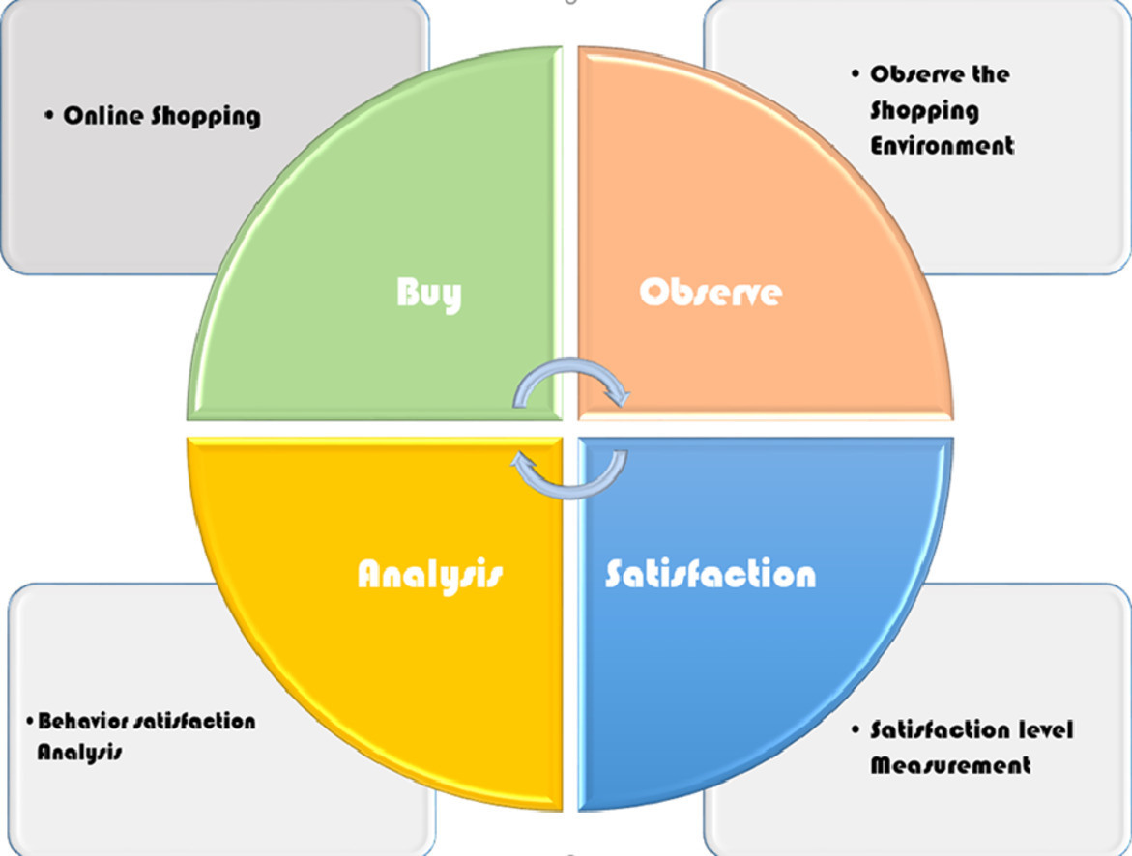
METHODOLOGY

Slide 9
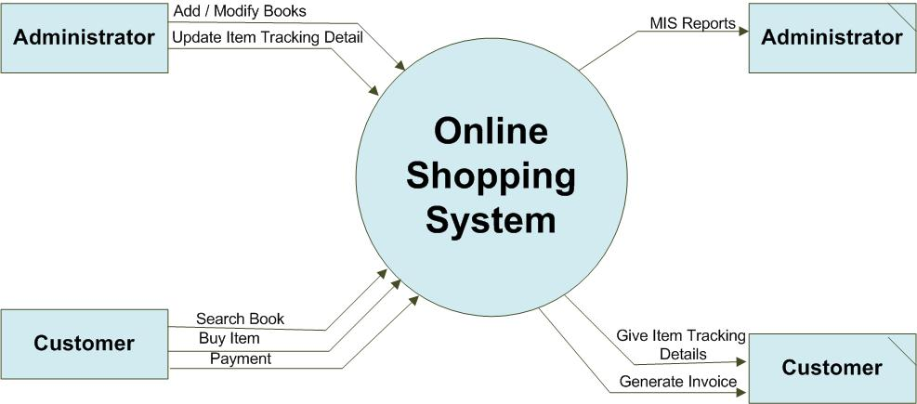
LEVEL 0 DFD

Slide 10
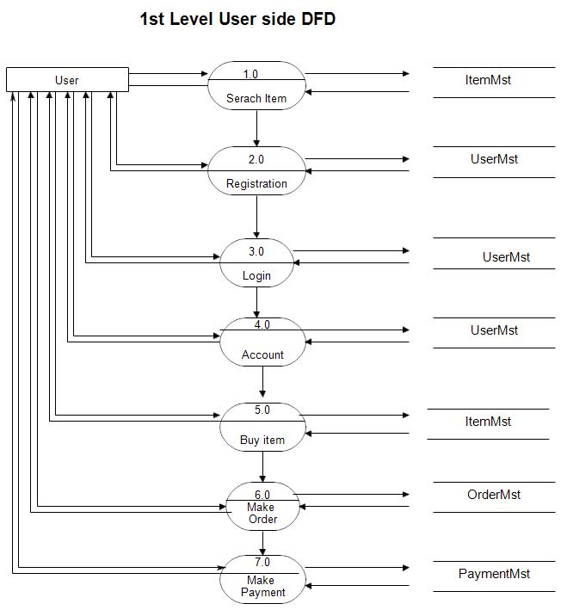
LEVEL 1 DFD

Slide 11
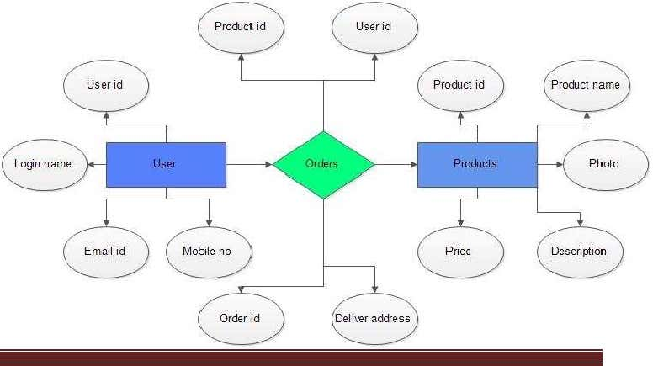
E-R DIAGRAM

Slide 12
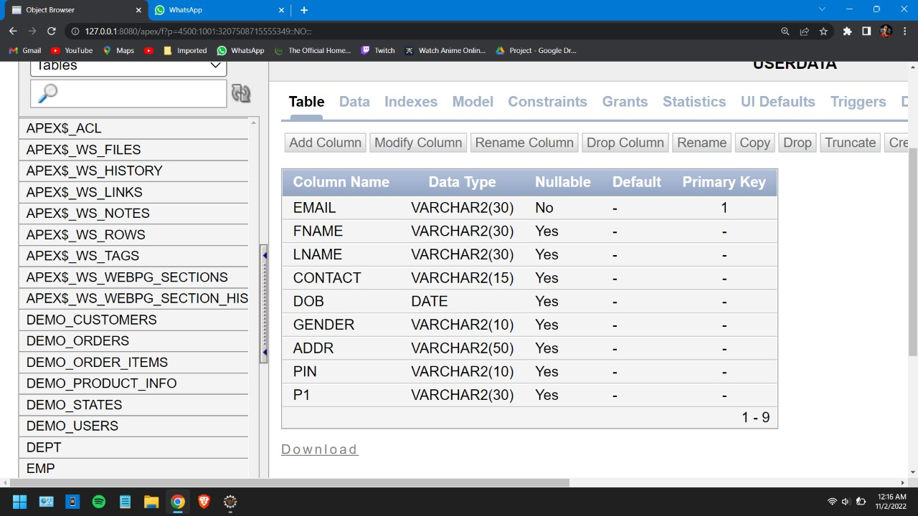
TABLES
USERDATA:

Slide 13
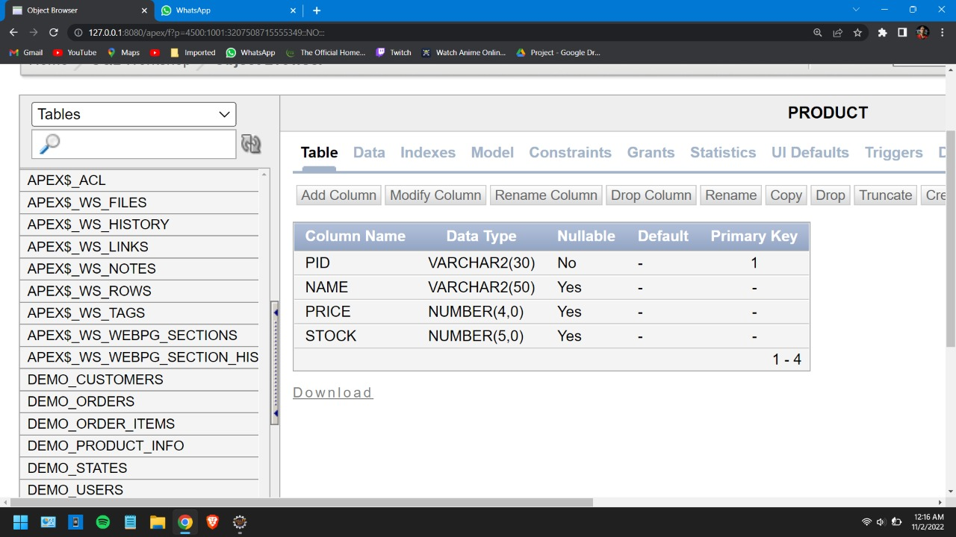
TABLES
PRODUCT

Slide 14
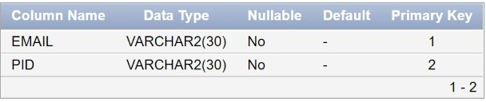
TABLES
CART :

Slide 15
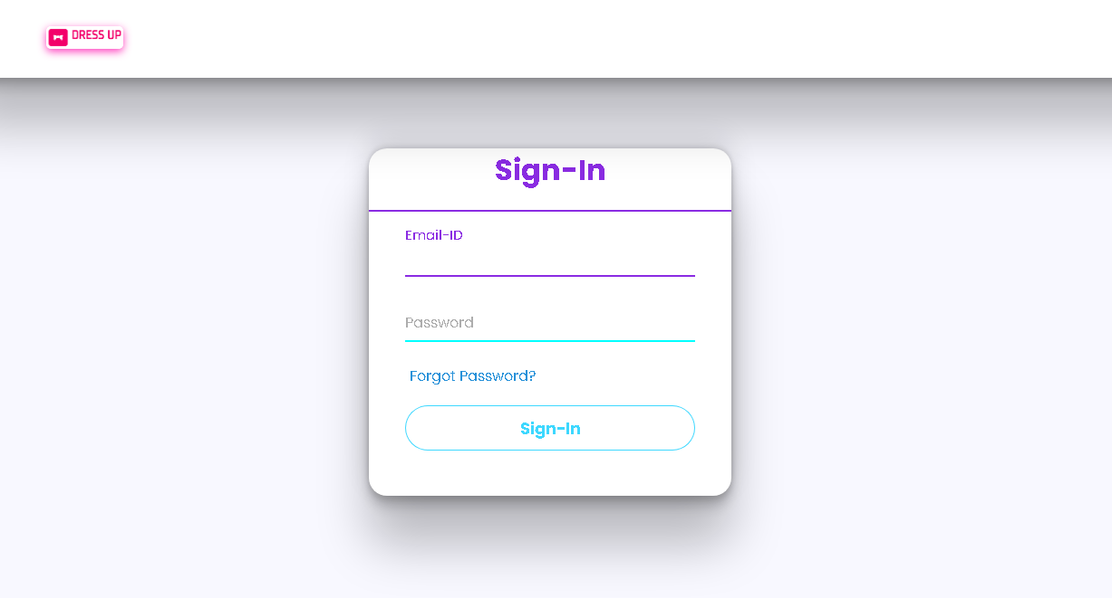
SNAPSHOTS
LOGIN PAGE :

Slide 16
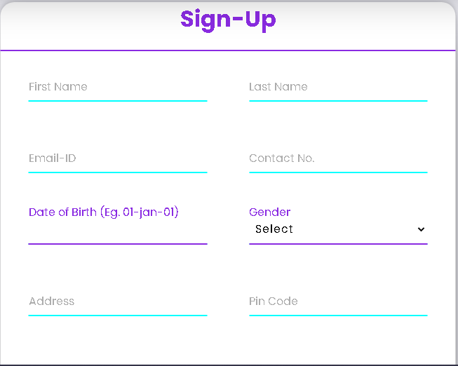
SNAPSHOTS
SIGN UP PAGE :

Slide 17
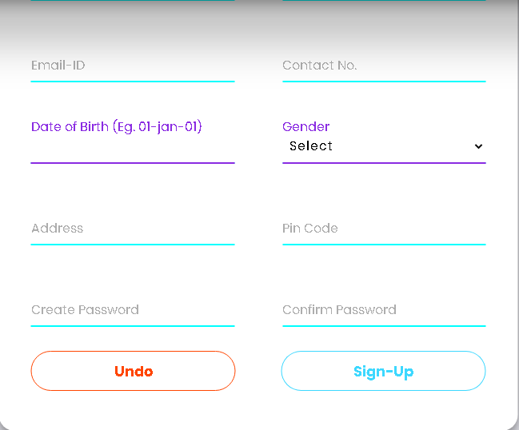
SNAPSHOTS
SIGN UP PAGE :

Slide 18
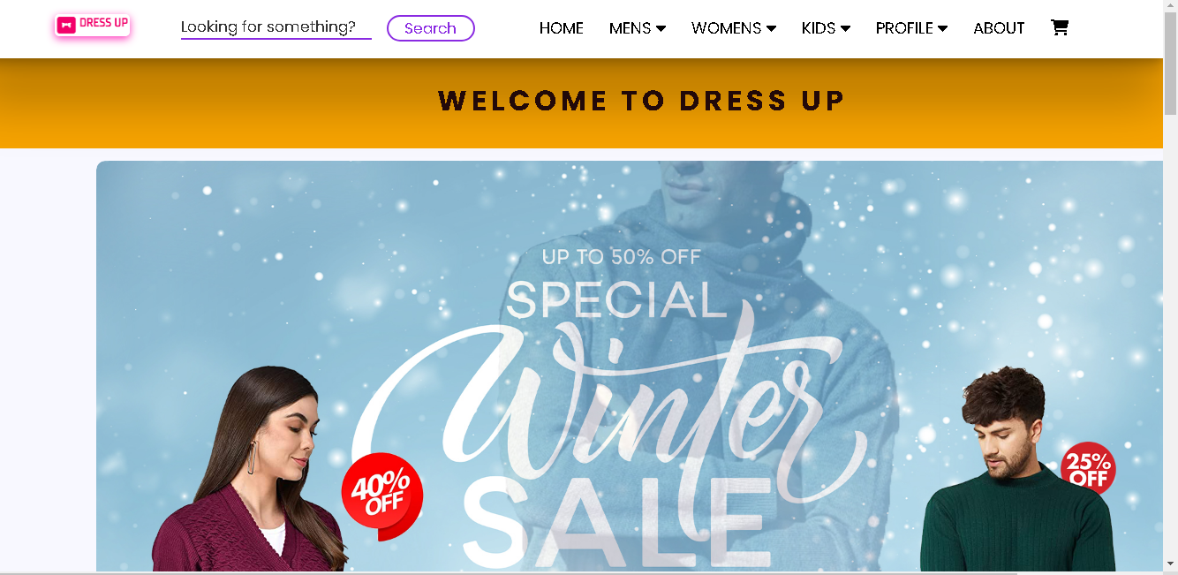
SNAPSHOTS
AFTER SUCCESSFULLY LOGIN :

Slide 19
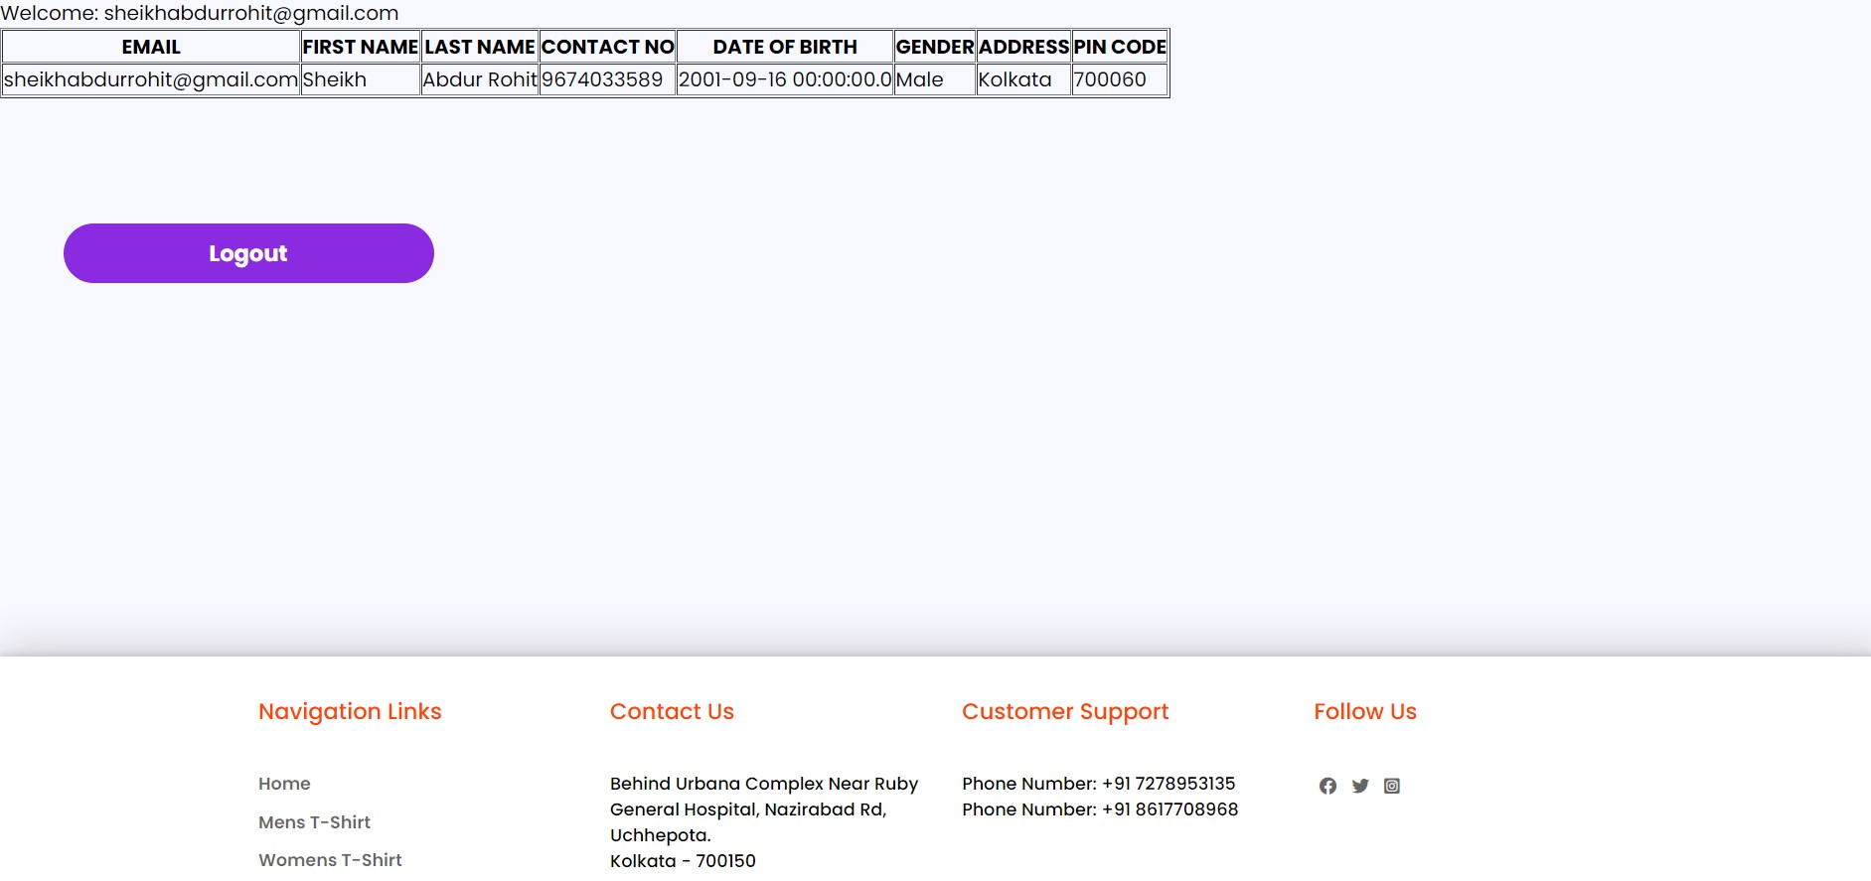
SNAPSHOTS
PROFILE:

Slide 20
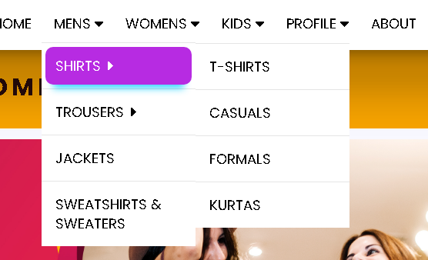
SNAPSHOTS
PRODUCT VIEW:

Slide 21
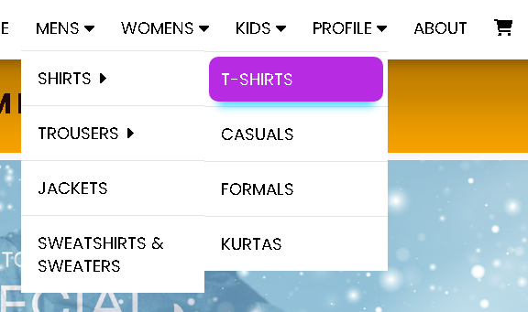
SNAPSHOTS
PRODUCT VIEW:

Slide 22
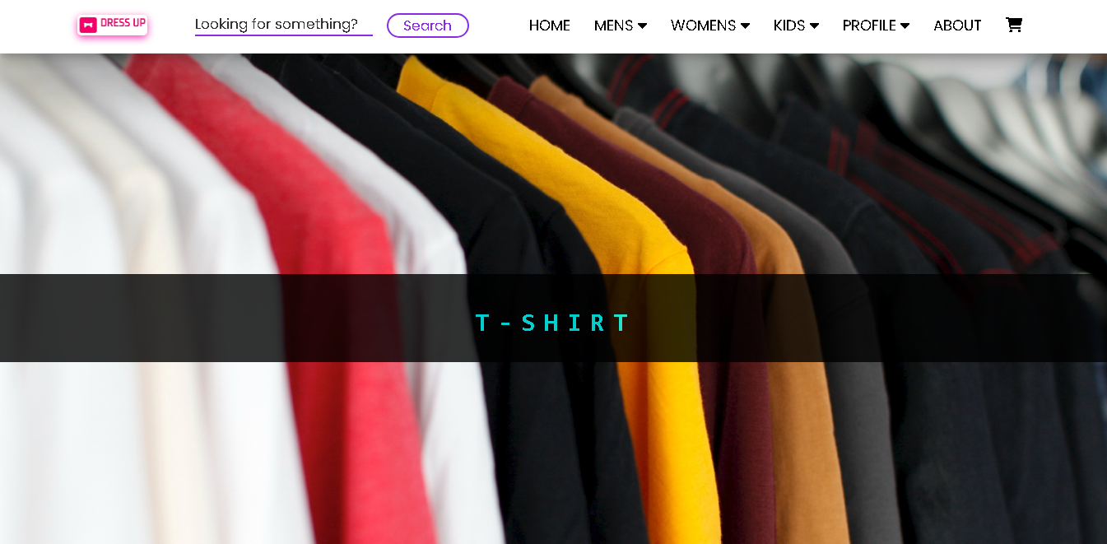
SNAPSHOTS
PRODUCT VIEW:

Slide 23
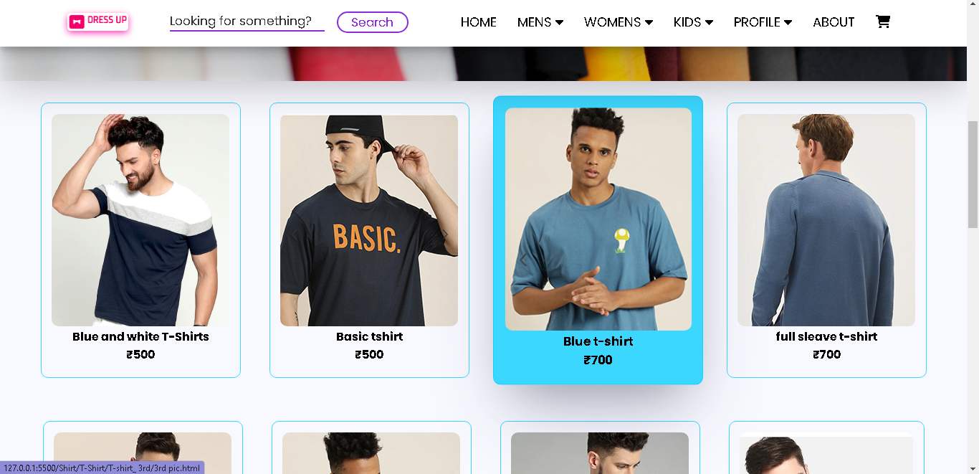
SNAPSHOTS
PRODUCT VIEW:

Slide 24
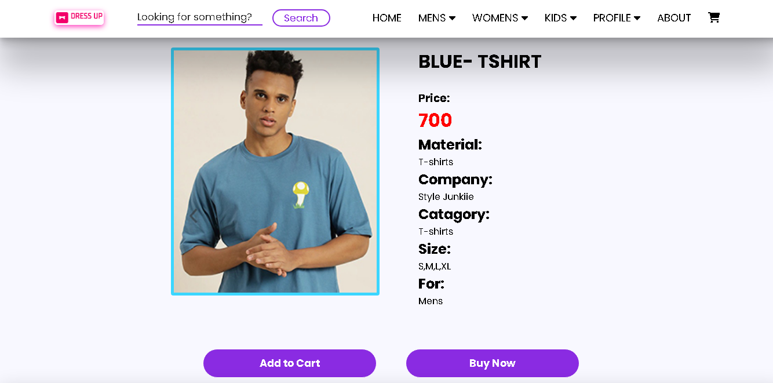
SNAPSHOTS
PRODUCT VIEW:

Slide 25
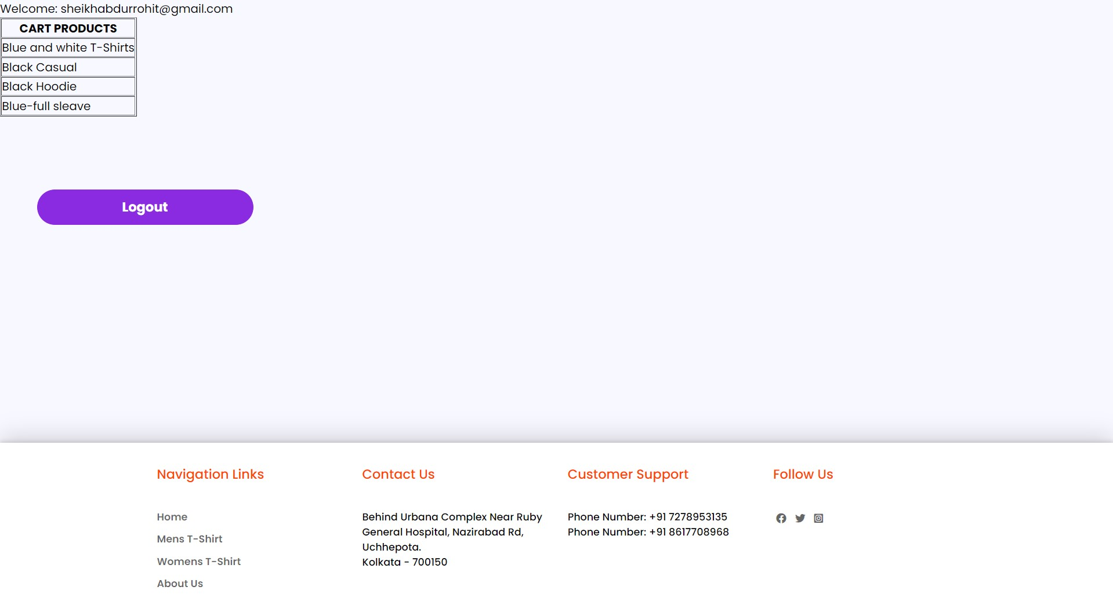
SNAPSHOTS
CART:

Slide 26
SNAPSHOTS
PROFILE:

Slide 27
SNAPSHOTS
CART DETAILS:

Slide 28
FUTURE SCOPE
Our designed online shopping system provides a 24×7 service, that is customers can surf the website, place orders anytime they wish to. Also, the delivery system works 24×7 hours a week. Some of the features that can be modified and added to this system in the future involve its implementation by local shopkeepers, where shops will be providing an online interface to customers for shopping and placing orders.
Then some delivery persons can perform their work. This will be adding on benefit for the customers as it will save their time, plus it adds on for the shopkeepers also, as people will continue to shop from local shops rather than preferring to supermarkets every time.

Slide 29
CONCLUSION
Technology has made significant progress over the years to provide consumers a better online shopping experience and will continue to do so for years to come. With the rapid growth of products and brands, people have speculated that online shopping will overtake in-store shopping. While this has been the case in some areas, there is still demand for brick-and-mortar stores in market areas where the consumer feels more comfortable seeing and touching the product being bought. However, the availability of online shopping has produced a more educated consumer that can shop around with relative ease without having to spend a large amount of time. In exchange, online shopping has opened up doors to many small retailers that would never be in business if they had to incur the high cost of owning a brick-and-mortar store. At the end, it has been a win-win situation for both consumer and sellers.

